Slide 1
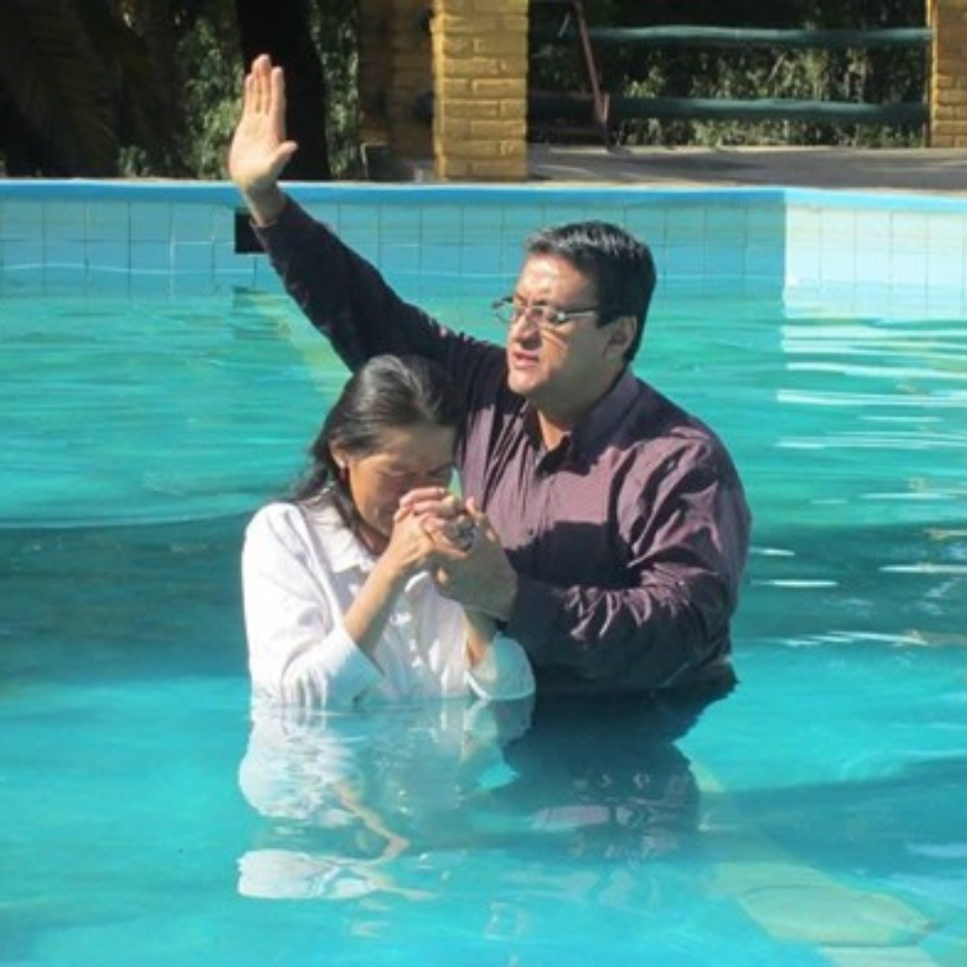

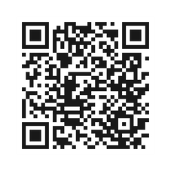

Ways to Give
Our offerings make
God’s work visible in the world.
IN PERSON
Place your offering in
the plate.
ONLINE
Scan the QR Code
or visit eTithing.org.

